Slide 1
Chain Responsibility Pattern

Slide 2
Chain Responsibility Definition :
is a design pattern consisting of a source of command objects and a series of processing objects. Each processing object contains logic that defines the types of command objects that it can handle; the rest are passed to the next processing object in the chain. A mechanism also exists for adding new processing objects to the end of this chain.

Slide 3
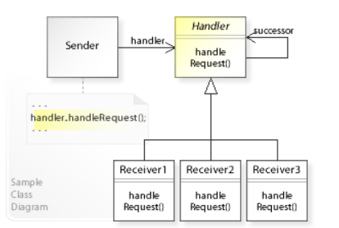
UML Diagram

Slide 4
Example
If the client want to pay some thing like product from online supermarket System,
he have three ways to payment PayPal , master and Qiwi in the system and it check if Balance in each card available to pay the thing or product ??
See the chain pattern will solve the problem by effectively way

Slide 5
Demo in javascript
Look at the Demo

Slide 6
Resources
https://www.youtube.com/watch?v=stpzkOFoWdY
https://github.com/YauhenKavalchuk/design-patterns/blob/master/behavioral/chain-of-responsibility/chain-of-responsibility.js

